Slide 1
Clean Code
By Robert (Bob) Martin
Presented by Ivan Pavlov

Slide 2
Design Patterns What are Design Patterns?

Slide 3
Design Patterns The Gang of Four Erich Gamma, Richard Helm, Ralph Johnson, John Vlissides

Slide 4
Usage of Design Pattern
Common Platform for developers
Basic Practices

Slide 5
Types of Design Patterns
Structural patterns
Behavioral patterns
Creational

Slide 6
Scope of design patterns
Class category
Object category

Slide 7
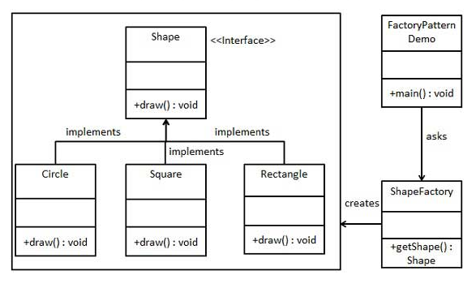
Factory Design Pattern
Notes:
Factory pattern is one of the most used design patterns in Java. This type of design pattern comes under creational pattern as this pattern provides one of the best ways to create an object.
In Factory pattern, we create object without exposing the creation logic to the client and refer to newly created object using a common interface.

Slide 8
Design Patterns
interface Shape{
draw()
}
class Rectangle implements Shape{
draw(){
Draw rectangle
}
}
class Square implements Shape{
draw(){
Draw square
}
}
class ShapeFactory{
shapeType = user.input
if shapeType is Rectangle{
return Retangle
}
if shapeType is Square{
return Square
}
}
Factory Design Pattern

Slide 9
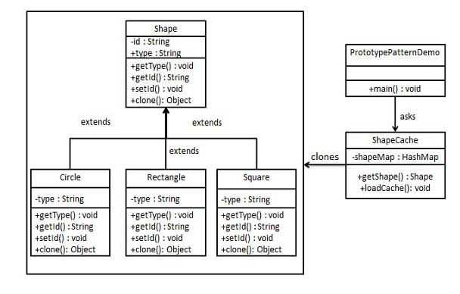
Prototype Design Pattern
Notes:
Creating new objects(instances) by cloning (copying) other objects
Example: in game development where a prototype warrior could be cloned to add numbers and types to an army.

Slide 10

Design Patterns
abstract Shape{
id
draw()
clone()
setId()
}
class Rectangle implements Shape{
draw(){
Draw rectangle
}
}
class Square implements Shape{
draw(){
Draw square
}
}
class ShapeCashe{
shapes
getShape(shape,shapeID){
shape = get(shapeID)
return clone(shape)
}
static loadShapes(){
rectangle = new Rectangle
shapes push(rectangle)
square = new Square
shapes push(square)
}
}
class PrototypeShapes(){
ShapeCashe.loadShapes()
if user.input = rectangle{
return ShapeCashe.get(rectangleID)
}
...
}
Prototype Design Pattern

Slide 11
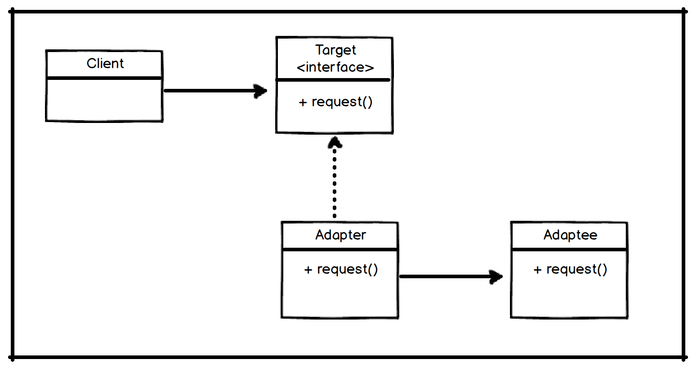
Adapter Design Pattern
Notes:
Creating new objects(instances) by cloning (copying) other objects
Example: in game development where a prototype warrior could be cloned to add numbers and types to an army.

Slide 12
Design Patterns
class Facebook {
function postToWall(){
print "Post something";
}
}
interface SocialMediaAdapter{
function post(msg);
}
class FacebookAdapter implements SocialMediaAdapter{
private facebook;
public function __construct(Facebook $facebook){
this facebook = facebook;
}
public function post(msg){
this facebook.postToWall(msg);
}
}
facebook = new FacebookAdapter(new Facebook());
msg = getMessageFromUser();
....
Adapter Design Pattern

Slide 13
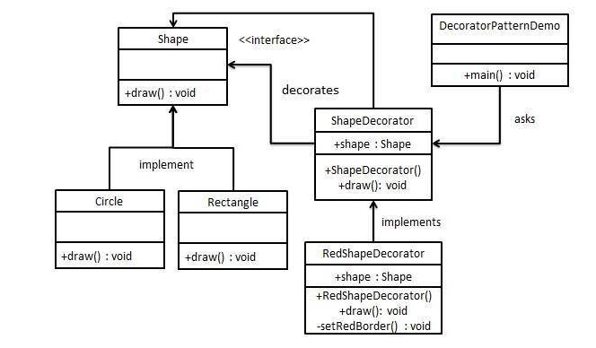
Decorator Design Pattern
Notes:
Decorator pattern allows a user to add new functionality to an existing object without altering its structure. This type of design pattern comes under structural pattern as this pattern acts as a wrapper to existing class.
This pattern creates a decorator class which wraps the original class and provides additional functionality keeping class methods signature intact.
We are demonstrating the use of decorator pattern via following example in which we will decorate a shape with some color without alter shape class.

Slide 14
Decorator Design Pattern
interface shape{
public draw()
}
class Rectangle implements Shape{
public draw()
}
class Circle implements Shape{
public draw()
}
abstract class ShapeDecorator implements Shape{
protected Shape decoratedShape;
construct(Shape decoratedShape){
this decoratedShape = decoratedShape
}
public draw()
}
class RedShapeDecorator extends ShapeDecorator{
construct(Shape decoratedShape){
this decoratedShape = decoratedShape
}
draw(){
setRedBorder(decoratedShape)
}
setRedBorder(shape decoratedShape){
Border color: red
}
}
redRectangle = RedShapeDecorator(new Rectangle())
redRectangle.draw()
redCircle = RedShapeDecorator(new Circle())
redCircle.draw()
Notes:
Decorator pattern allows a user to add new functionality to an existing object without altering its structure. This type of design pattern comes under structural pattern as this pattern acts as a wrapper to existing class.
This pattern creates a decorator class which wraps the original class and provides additional functionality keeping class methods signature intact.
We are demonstrating the use of decorator pattern via following example in which we will decorate a shape with some color without alter shape class.

Slide 15
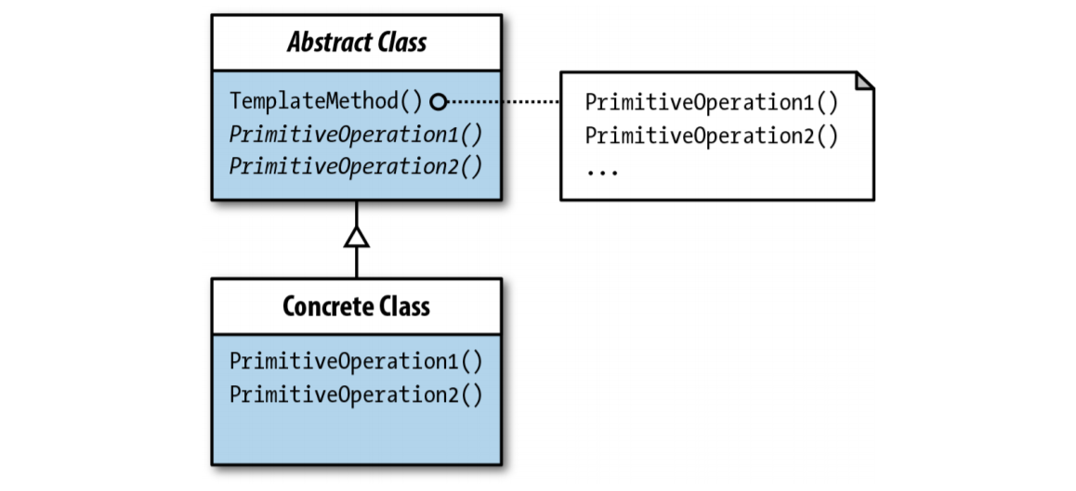
Template Design Pattern
Notes:
The Template Method pattern suggests that you break down an algorithm
The steps may either be abstract, or have some default implementation. To use the algorithm, the client is supposed to provide its own subclass, implement all abstract steps, and override some of the optional ones if needed (but not the template method itself).m into a series of steps, turn these steps into methods, and put a series of calls to these methods inside a single “template method.”

Slide 16
Template Design Pattern
abstract class AbstractClass{
protected pix
protected cap
function templateMethod(pixNow, capNow){
this pix = pixNow
this cap = capNow
addPix(this pix)
addCaption(this cap)
}
abstract function addPix(pix)
abstract function addCaption(cap)
}
class ConcreteClass extends AbstractClass{
function addPix(pix){
this pix = pix
echo "<img src="images/{this pix}"><br/>"
}
function addCaption($cap){
this cap = cap
echo "<em>Caption: {$this cap}</em>"
}
}
caption = "Some Text"
image = new ConcreteClass()
image.templateMethod('image1.png',caption)
Notes:
The Template Method pattern suggests that you break down an algorithm
The steps may either be abstract, or have some default implementation. To use the algorithm, the client is supposed to provide its own subclass, implement all abstract steps, and override some of the optional ones if needed (but not the template method itself).m into a series of steps, turn these steps into methods, and put a series of calls to these methods inside a single “template method.”

Slide 17
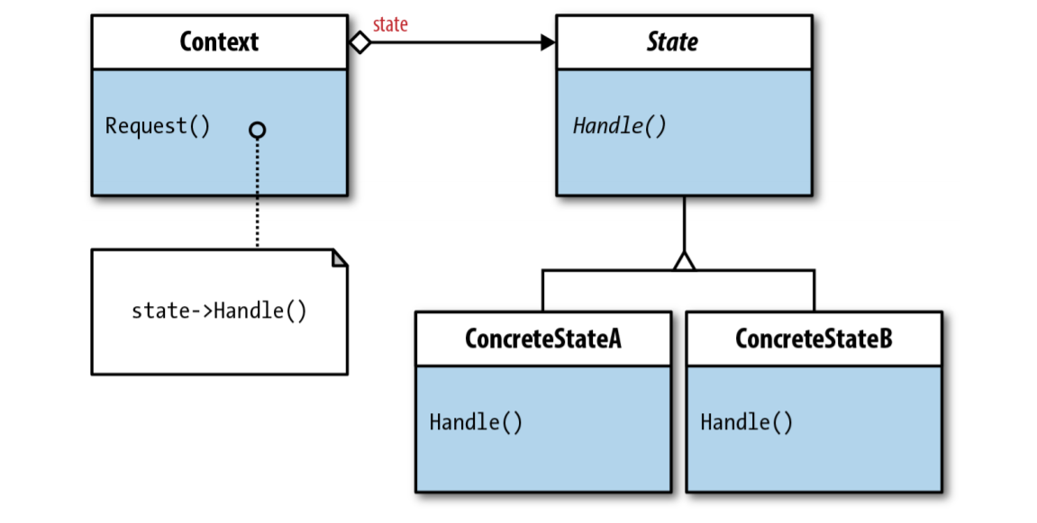
State Design Pattern
Notes:
State is a behavioral design pattern that lets an object alter its behavior when its internal state changes. It appears as if the object changed its class.
When to use?
Virtually every application in PHP has some state changes, but when an object depends on its state, which must be changed frequently, the State pattern has decided advantages.

Slide 18
State Design Pattern Context class
class Context{
private offState
private onState
private currentState
construct(){
this offState = new OffState(this)
this onState = new OnState(this)
//begining state is off
this currentState = this offState
}
public function turnOnLight(){
this currentState.turnLightOn()
}
public function turnOffLight(){
this currentState.turnLightOff()
}
public function setState(IState state){
this currentState = state
}
public function getOnState(){
return this onState
}
public function getOffState(){
return this offState
}
}
Notes:
The Context class summary The Context instantiates instances of all states and sets the default state. It has methods to trigger different states by calling the parallel methods in the concrete states. A setter Light On, Light Off: The Minimal State Design Pattern | 195 www.it-ebooks.info method keeps track of which state is the current one. To help keep track of the current state, Context has getters for each state when calls for changes in state occur.

Slide 19
State Design Pattern Concrete classes
interface IState{
public function turnLightOn()
public function turnLightOff()
}
class OnState implements IState{
private context
construct(Context contextNow){
this context = contextNow
}
public function turnLightOn(){
print "Light is already on, take no action"
}
public function turnLightOff(){
print "Light is off"
this context.setState(this context.getOffState())
}
}
class OffState implements IState{
private context
construct(Context contextNow){
this context = contextNow
}
public function turnLightOn(){
print "Light is on!"
this context.setState(this context.getOnState());
}
public function turnLightOff(){
echo "Light is already off, take no action"
}
}
Notes:
Both the OnState and OffState classes are simple implementations of IState, and the states are indicated by text messages. The state classes hold a reference to the Context class in their constructor functions. Recall that the Context instantiates state instances with a self-reference to the state constructor classes.

Slide 20
State Design Pattern Client classes
class Client
{
private context;
construct()
{
this context=new Context();
this context.turnOnLight();
this context.turnOnLight();
this context.turnOffLight();
this context.turnOffLight();
}
}
worker=new Client()
Notes:
Both the OnState and OffState classes are simple implementations of IState, and the states are indicated by text messages. The state classes hold a reference to the Context class in their constructor functions. Recall that the Context instantiates state instances with a self-reference to the state constructor classes.

Slide 21
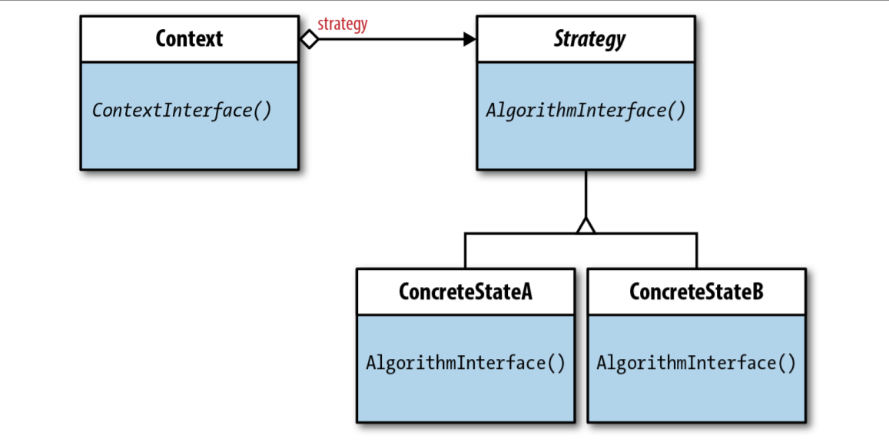
Strategy Design Pattern
Notes:
The Strategy pattern suggests that you take a class that does something specific in a lot of different ways and extract all of these algorithms into separate classes called strategies.
The original class, called context, must have a field for storing a reference to one of the strategies. The context delegates the work to a linked strategy object instead of executing it on its own.
The context isn’t responsible for selecting an appropriate algorithm for the job. Instead, the client passes the desired strategy to the context. In fact, the context doesn’t know much about strategies. It works with all strategies through the same generic interface, which only exposes a single method for triggering the algorithm encapsulated within the selected strategy.
This way the context becomes independent of concrete strategies, so you can add new algorithms or modify existing ones without changing the code of the context or other strategies.

Slide 22
Strategy Design Pattern
interface Strategy{
function math(a, b)
}
class ConcreteStrategyAdd implements Strategy{
function math(a, b){
return a + b
}
}
class ConcreteStrategySubstract implements Strategy{
function math(a, b){
return a - b
}
}
class ConcreteStrategyMultiply implements Strategy{
function math(a, b){
return a * b
}
}
class Context {
private Strategy Strategy
function setStrategy(Strategy strategy){
this.strategy = strategy
}
function executeStrategy(int a, int b){
return strategy.math(a, b)
}
}
Notes:
The Strategy pattern suggests that you take a class that does something specific in a lot of different ways and extract all of these algorithms into separate classes called strategies.
The original class, called context, must have a field for storing a reference to one of the strategies. The context delegates the work to a linked strategy object instead of executing it on its own.
The context isn’t responsible for selecting an appropriate algorithm for the job. Instead, the client passes the desired strategy to the context. In fact, the context doesn’t know much about strategies. It works with all strategies through the same generic interface, which only exposes a single method for triggering the algorithm encapsulated within the selected strategy.
This way the context becomes independent of concrete strategies, so you can add new algorithms or modify existing ones without changing the code of the context or other strategies.

Slide 23
Strategy Design Pattern
context = new Context()
action = user.input
firstNumber = user.input
secondNumber = user.input
switch(action){
case 'Add':
context.setStrategy(new ConcreteStrategyAdd())
break
case 'Substract':
context.setStrategy(new ConcreteStrategySubstract())
break
case 'Multiply':
context.setStrategy(new ConcreteStrategyMultiply())
break
default:
print 'Unexistant action'
break
}
result = context.executeStrategy(a, b)
print result
Notes:
The Strategy pattern suggests that you take a class that does something specific in a lot of different ways and extract all of these algorithms into separate classes called strategies.
The original class, called context, must have a field for storing a reference to one of the strategies. The context delegates the work to a linked strategy object instead of executing it on its own.
The context isn’t responsible for selecting an appropriate algorithm for the job. Instead, the client passes the desired strategy to the context. In fact, the context doesn’t know much about strategies. It works with all strategies through the same generic interface, which only exposes a single method for triggering the algorithm encapsulated within the selected strategy.
This way the context becomes independent of concrete strategies, so you can add new algorithms or modify existing ones without changing the code of the context or other strategies.

